Slide 1
Bayesian Statistics
Graphical Models and BUGS Programming
Brani Vidakovic
Professor
School of Industrial and Systems Engineering

Slide 2
Before We Begin…
In this unit:
Graphical Models
WinBUGS/ DoodleBUGS
More About WinBUGS
Other Bayesian Software

Slide 3

Graphical Models
DAGs
Independence of nodes ($d$-separation)

Slide 4
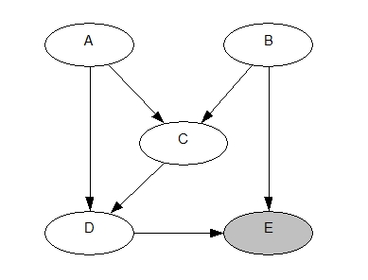
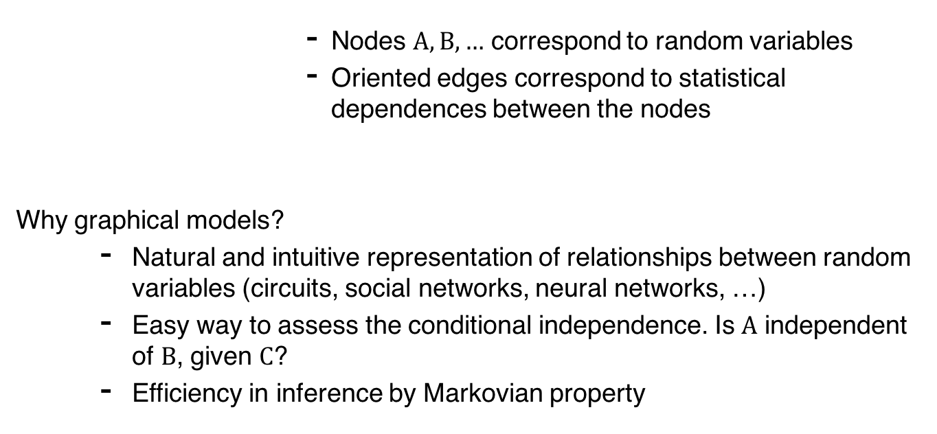
Graphical Models
Nodes $A,B,…$ correspond to random variables
Oriented edges correspond to statistical dependences between the nodes
Why graphical models?
Natural and intuitive representation of relationships between random variables (circuits, social networks, neural networks, …)
Easy way to assess the conditional independence. Is $A$ independent of $B$, given $C$?
Efficiency in inference by Markovian property

Slide 5
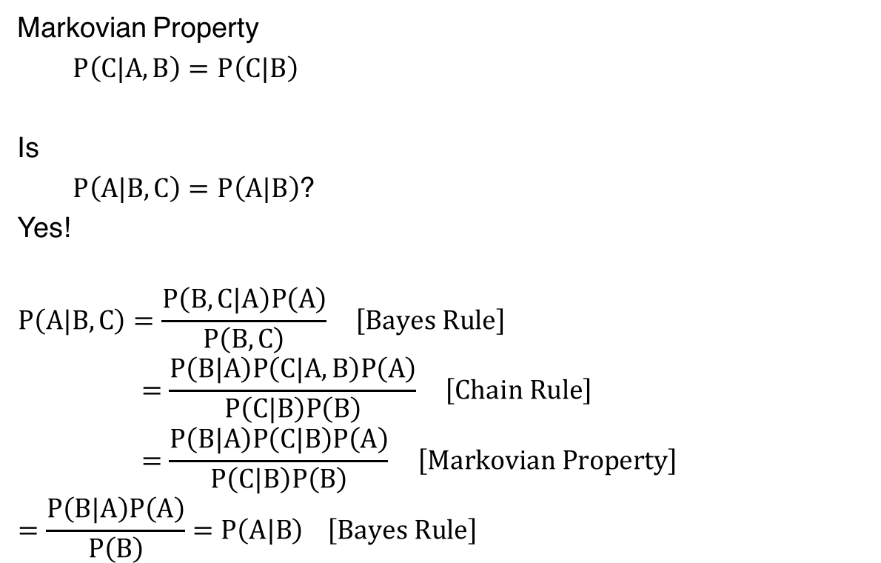
A
Markovian Property
$P\left(C|A,B\right)=P\left(C|B\right)$
Is
$P\left(A|B,C\right)=P\left(A|B\right)$?
Yes!
$$P\left(A|B,C\right)=\frac{P\left(B,C|A\right)P\left(A\right)}{P\left(B,C\right)} \left[Bayes Rule\right]$$
$$=\frac{P\left(B|A\right)P\left(C|A,B\right)P\left(A\right)}{P\left(C|B\right)P\left(B\right)} \left[Chain Rule\right]$$
$$=\frac{P\left(B|A\right)P\left(C|B\right)P\left(A\right)}{P\left(C|B\right)P\left(B\right)} \left[Markovian Property\right]$$
$$=\frac{P\left(B|A\right)P\left(A\right)}{P\left(B\right)}=P\left(A|B\right) \left[Bayes Rule\right]$$
B
C

Slide 6
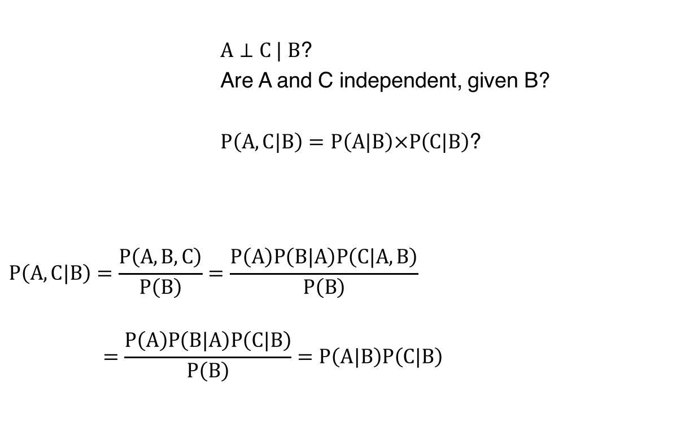
A
$A⊥C | B$?
Are A and C independent, given B?
$P\left(A,C|B\right)=P\left(A|B\right)×P\left(C|B\right)$?
$$P\left(A,C|B\right)=\frac{P\left(A,B,C\right)}{P\left(B\right)}=\frac{P\left(A\right)P\left(B|A\right)P\left(C|A,B\right)}{P\left(B\right)}$$
$$=\frac{P\left(A\right)P\left(B|A\right)P\left(C|B\right)}{P\left(B\right)}=P\left(A|B\right)P\left(C|B\right)$$
B
C
unobserved
observed
Bayes Formula

Slide 7
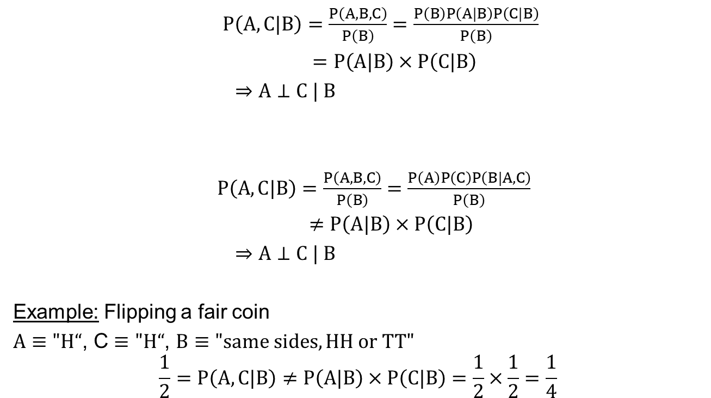
$P\left(A,C|B\right)=\frac{P\left(A,B,C\right)}{P\left(B\right)}=\frac{P\left(B\right)P\left(A|B\right)P\left(C|B\right)}{P\left(B\right)}$
$=P\left(A|B\right)×P\left(C|B\right)$
$⇒A⊥C | B$
$P\left(A,C|B\right)=\frac{P\left(A,B,C\right)}{P\left(B\right)}=\frac{P\left(A\right)P\left(C\right)P\left(B|A,C\right)}{P\left(B\right)}$
$$≠P\left(A|B\right)×P\left(C|B\right)$$
$⇒A⊥C | B$
Example: Flipping a fair coin
$A≡"H“$, C $≡"H“$, $B≡"same sides, HH or TT"$
$$\frac{1}{2}=P\left(A,C|B\right)≠P\left(A|B\right)×P\left(C|B\right)=\frac{1}{2}×\frac{1}{2}=\frac{1}{4}$$
B
A
C
A
C
B

Slide 8
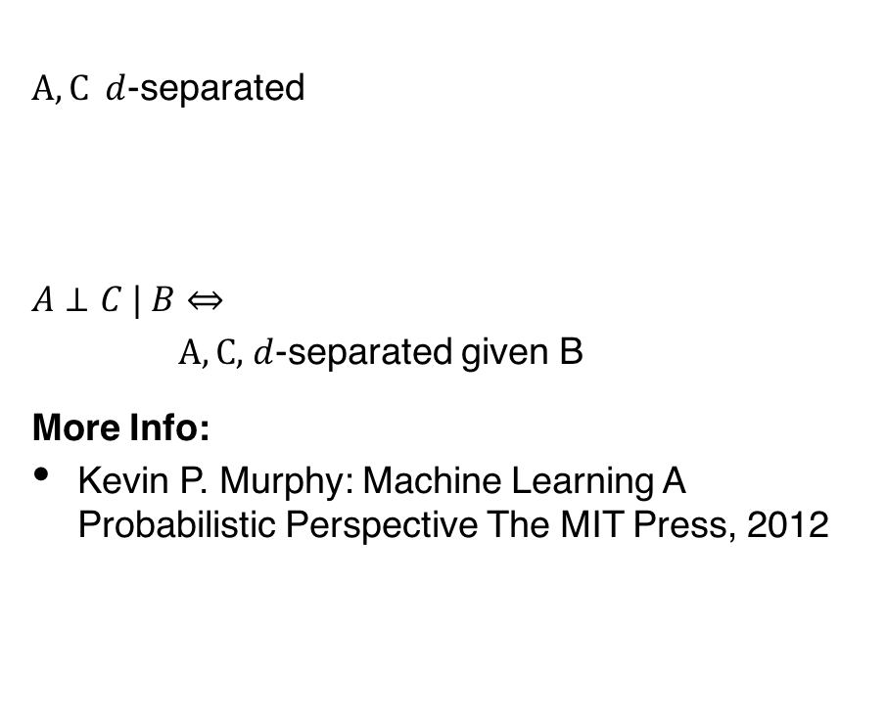




A
B
C
A
B
C
$A, C d$-separated
$A⊥C | B⇔$
$A,C,$ $d$-separated given B
More Info:
Kevin P. Murphy: Machine Learning A Probabilistic Perspective The MIT Press, 2012
$$B∈Ε$$
B
A
C
A
C
$$B∉Ε$$
B
$$⋮$$
$Ε−$evidence, observed nodes

Slide 9
Summary

